Slide 1

Fifa Word Cup 2022 Dataset with Unsupervised Machine Learning
Kao Chiam Saelee

Slide 2
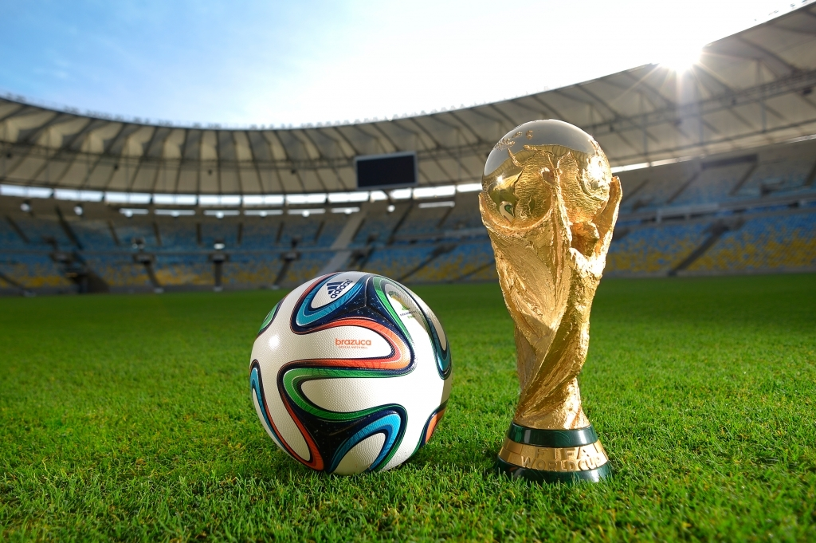
Introduction
The Fifa World Cup is the largest soccer tournament in the world. It begin in 1930 and occurs every 4 years since then.
We will be analyzing the Fifa World Cup 2022 Data from Kaggle.com using machine learning approaches, particularly supervised learning, to make predictions.
This Photo by Unknown Author is licensed under CC BY-NC-ND

Slide 3
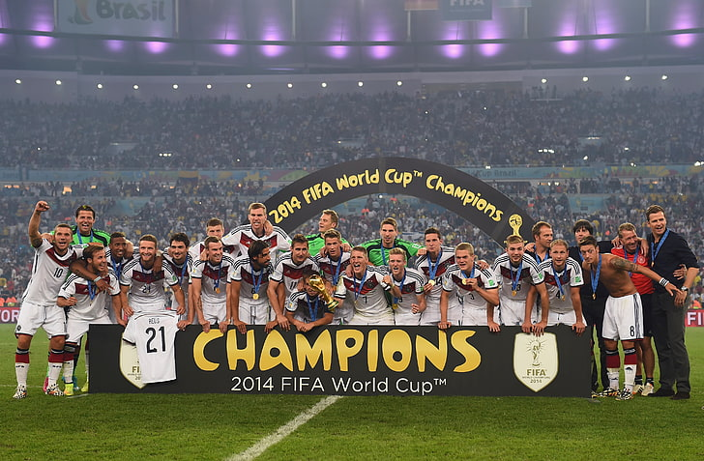
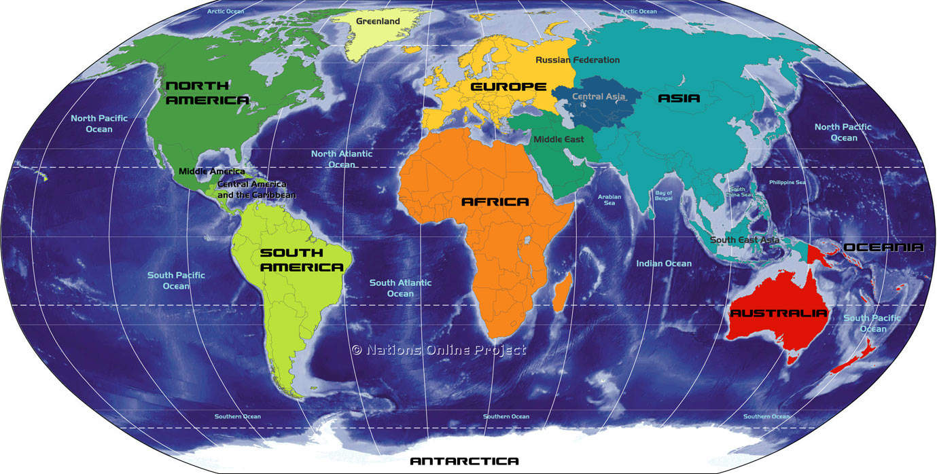
Questions
Can we predict home team continent?
Does home team have an advantage?
This Photo by Unknown Author is licensed under CC BY-NC

Slide 4
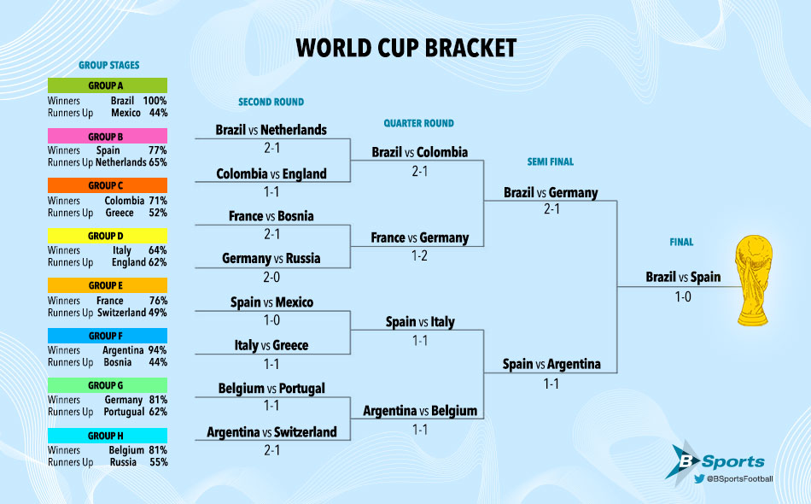
Overview
Load data, Exploratory Data Analysis (EDA), and cleaning
Data preprocessing and dimensionality reduction with PCA
Hierarchical, Kmeans clustering and performance evaluation
Compare unsupervised clustering to supervised models: cnb, knn, adb and rf
Discussion/Conclusion
This Photo by Unknown Author is licensed under CC BY-NC-ND

Slide 5
Exploratory Analysis/ Data Visualization

Slide 6
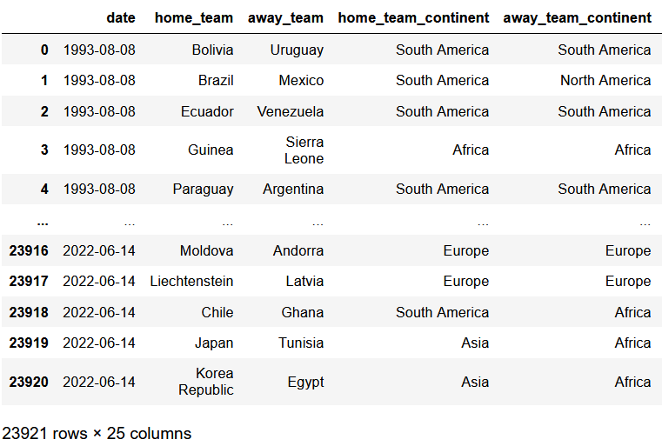
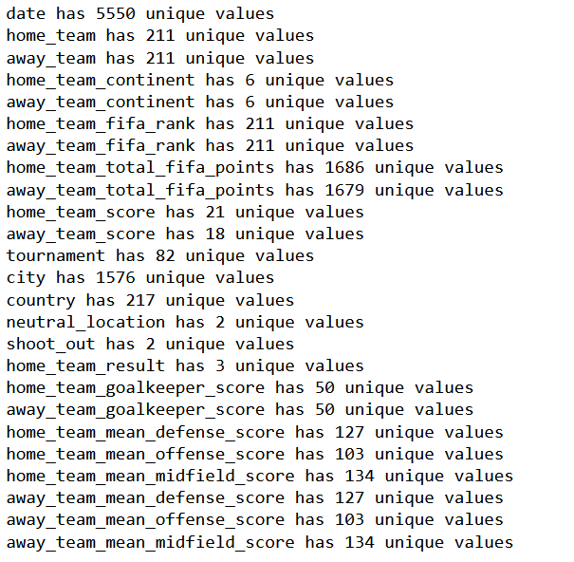
Read and Examine Dataset

Slide 7
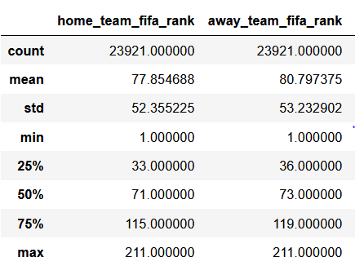
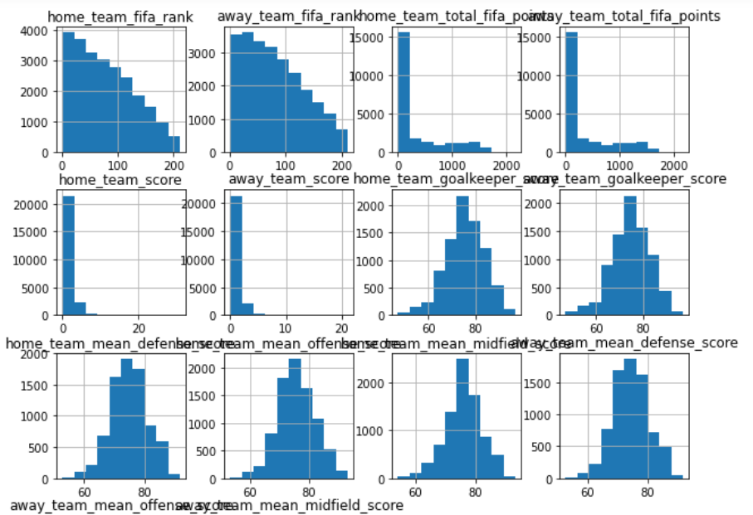
Data Statistics

Slide 8
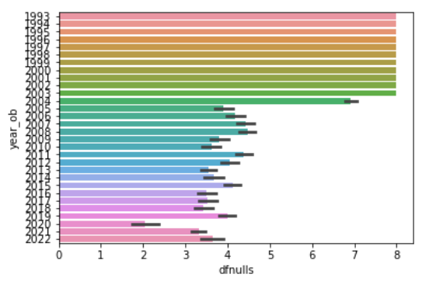
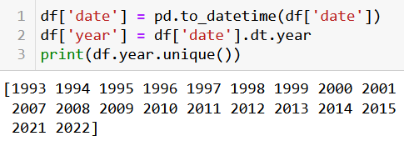
Missing Data
View null values and impute missing data
Extract year from date and filter by year

Slide 9
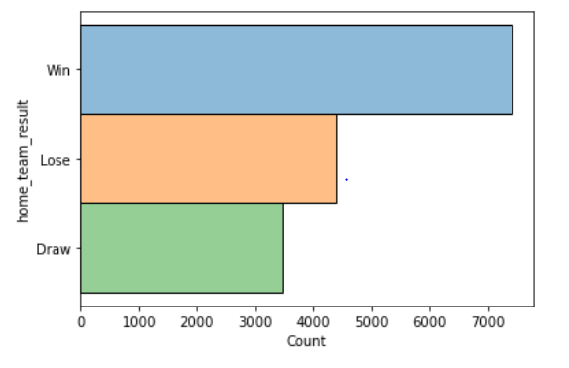
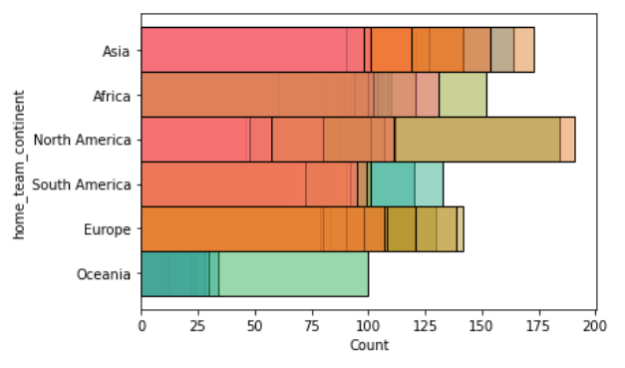
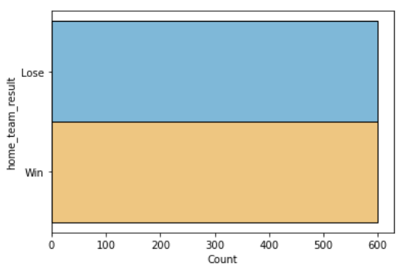
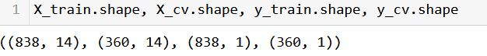
Get Label Columns The Split Train/Test
Home team wins, losses and draws
Home team continent data by countries

Slide 10
Data preprocessing and PCA

Slide 11
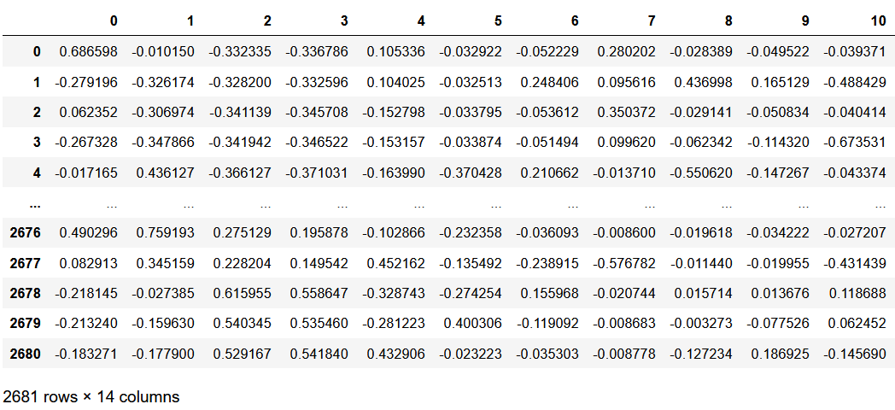
NormalIze and ScAle The Data

Slide 12
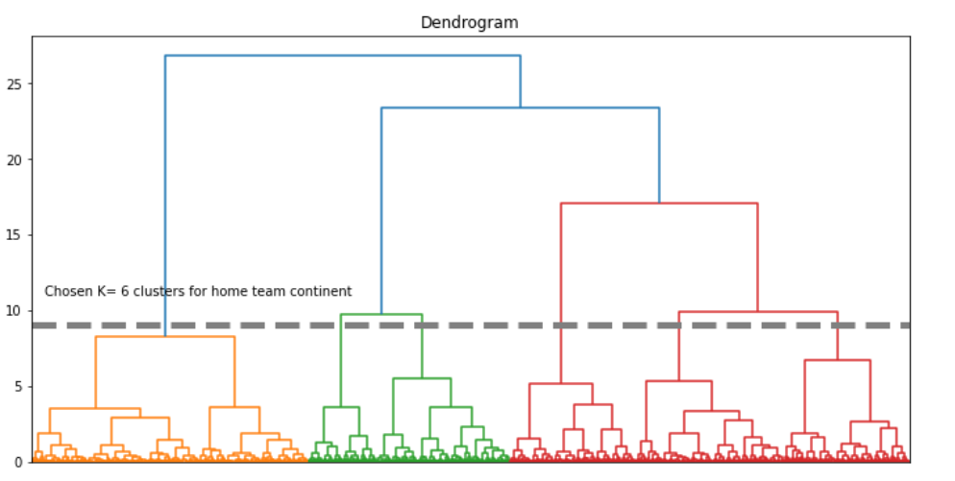
Dendrogram Through PCA

Slide 13
Hierarchical, Kmeans Clustering

Slide 14
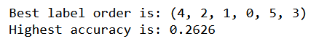
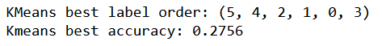
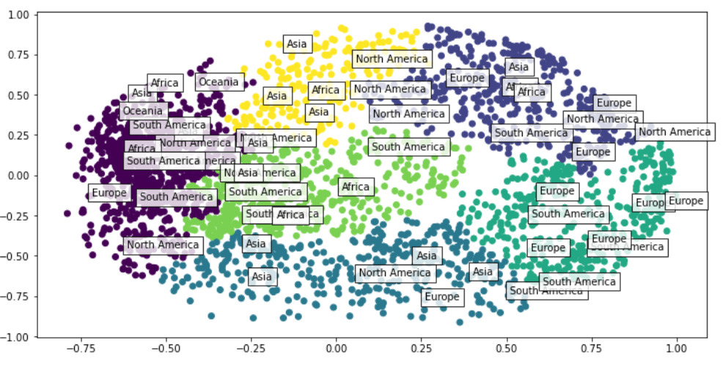
HiErarchical Clustering For Home Team continent

Slide 15
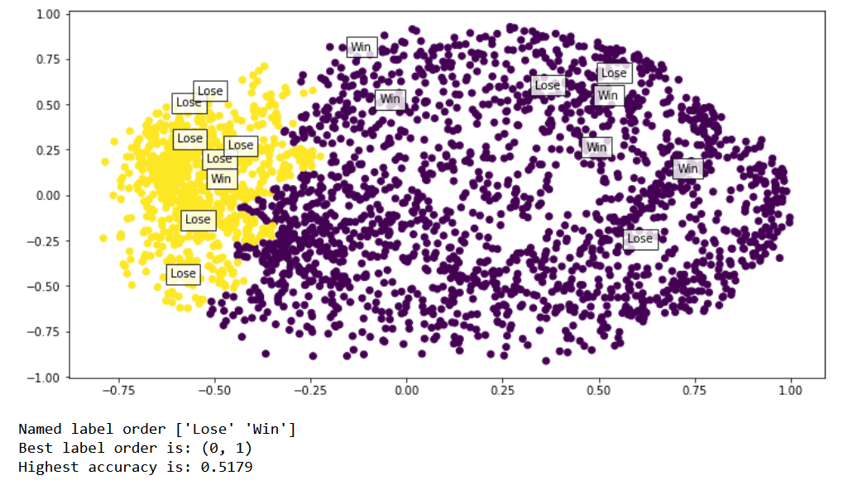
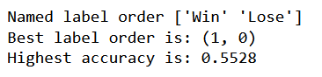
Heirarchical Clustering For Home Team Results
Results from the Validation/test set:

Slide 16
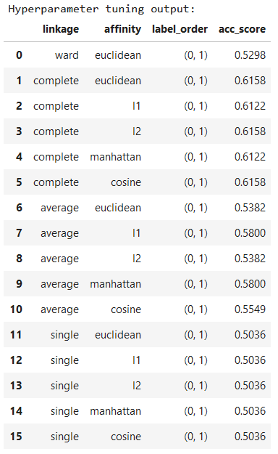
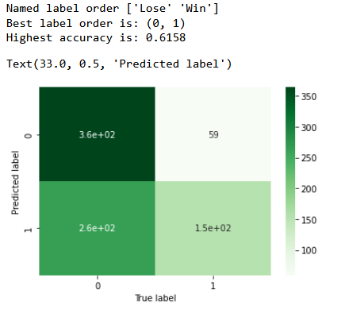
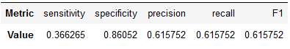
Hyperparameter tuning

Slide 17
Supervised Models

Slide 18
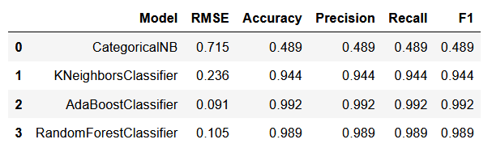
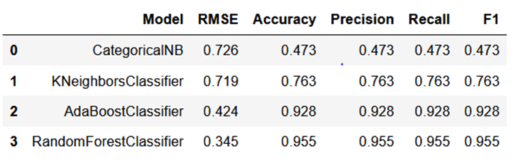
Tree Models have High Accuracy
Wins or Losses
Wins, Losses, or Draws

Slide 19
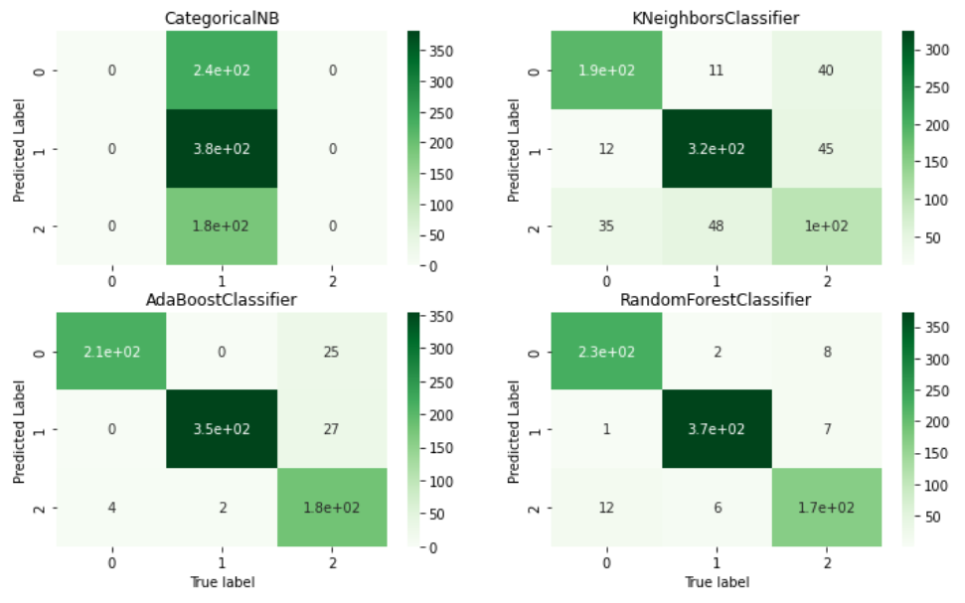
High Prediction Accuracy Overall

Slide 20
Conclusion

Slide 21
Conclusions
After analyzing the Fifa World Cup 2022 Dataset, here are our conclusions
1. Can we reliably cluster home team continent?
There’s an average rate of 16.67% per home team continent group if we were to divide them up evenly. Using unsupervised learning, we got a accuracy of 26% with hierarchical clustering and nearly 28% with K-means clustering when comparing our predicted cluster groups with our actual groups. This is not too bad but given the diversity of countries within each continent and fairly low accuracy scores, it is difficult to say in general if there are large difference between home team continents.
2. Does home team really have an advantage?
Our best hierarchical model had an accuracy score of 62% with specificity being very high (probability of actual negative outcome) and sensitivity being very low (probability of actual positive outcome). According to our unsupervised model we cannot conclude that there is significant home team advantage because our model is good at predicting losses but not wins.
On the contrary, our supervised learning models, especially tree models, had really high prediction accuracy but this may be deceiving because we would need to take a deeper look into the data itself and at how were running the models with certain hyperparameters to make sure we are not overfitting.
The full report can be found here: Fifa data full analysis and report
Notes:
Difficult for a city like NYC to enforce something like a curfew because of the sheer size of it’s population. Howver some things you can do to stay safe in theis city are
Focusing on location and time to avoid any unintended eithical issues from analysis of race for instance because there may be discrimnination going on

Slide 22
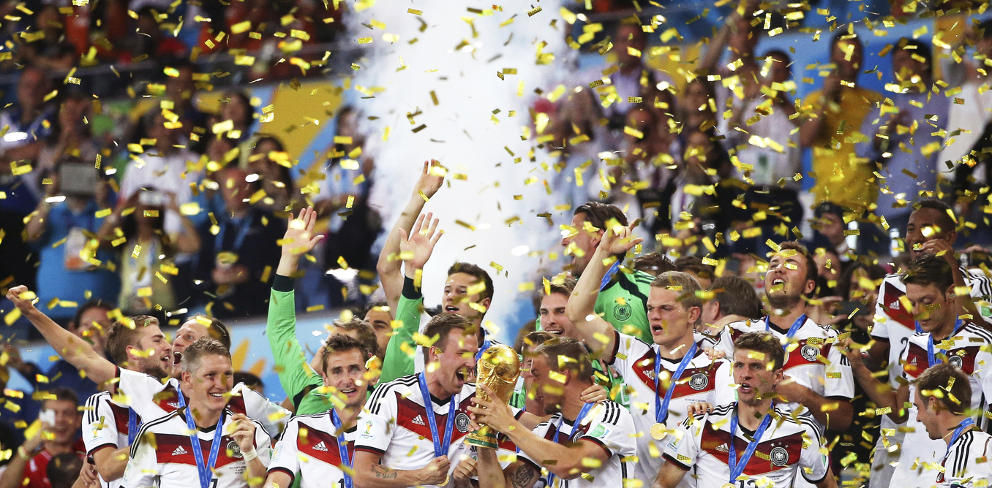
Thank You!
This Photo by Unknown Author is licensed under CC BY-ND

